Slide 1
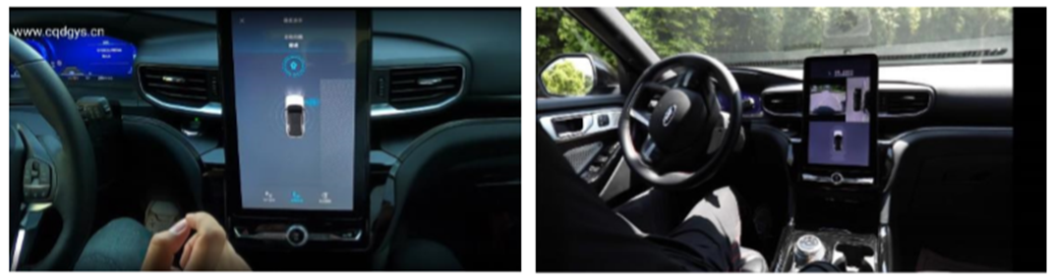
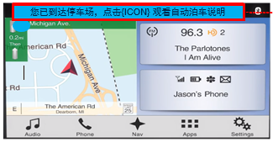
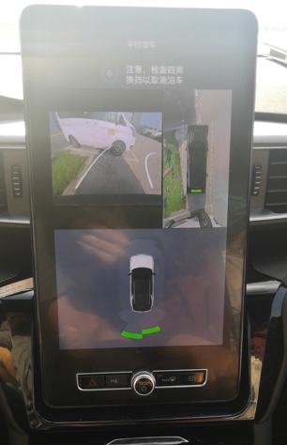
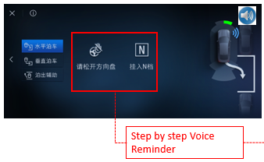
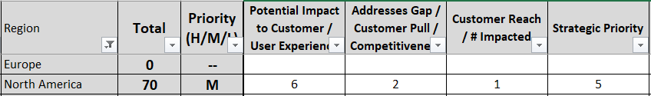
Tech. planning China
L3 Experience
Voice Enhanced Fully Automatic Parking Assist
Submitted 20CY
New One Pager
For customers, the most common way to turn around is to park the car. Automatic parking function can effectively help users to complete a series of operations without worrying about safety issues. In the parking process, voice prompt assistance and scene based use support can better assist users to experience the function. etc.
Customers can not easily understand the function and usage of ADAS. In the process of using FAPA, the specific operation steps also need a process of training and learning for novices. etc.
Navigator hint Optimization
Customers can easily understand the steps and operation methods of FAPA. In the process of use, accompanied by voice prompt, can be more assured of the liberation of hands to complete the entire parking function. The user will also be prompted to use the FAPA function in the scene after navigating to the parking lot.
Help Me Drive
Auto-Commute Experience?
Add audio guidance during the Auto Parking process to reduce driver stress.
*Add audio instructions at each step to guide driver through parking process
*In FAPA screen in auto parking process where Audio instruction can be added.
Add pop-up with hyper link to feature guide as soon as Navigation reaches destination.
Design and add an attractive icon shown below linked to FAPA video or E-manual that introduces the feature functions.
FAPA with Voice Reminder
Add voice reminder with VPA support in FAPA which is an enhancement over current solution in both use scenarios and automation levels, based on the same hardware platform. It strengthens Ford vehicles’ automation capability, make them more attractive to the customers.
IVI FAPA , Shortcut key(soft key)
Navigation, EManual book, Settings Info book,
VPA, Voice Reminder , Voice Q&A , Voice command , etc.
Notes:
需要包含：自车主动cut-in/lane change

Slide 2
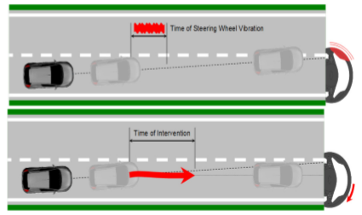
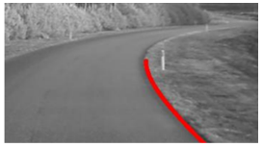
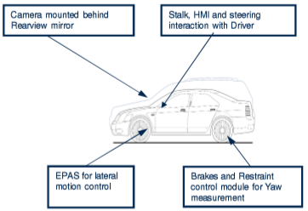
Tech. planning China
L3 Experience
Voice Enhanced Lane Keeping System(VE-LKS)
Submitted 20CY
New One Pager
If the customer does not pay attention to the driving process, fatigue driving and other situations will lead to lane departure, which will cause significant risk. LKS can effectively help users to keep straight driving when the speed is more than 65 km and there is lane line. With voice prompt, it can drive safely and comfortably.
Customers can turn on / off the LKS function through voice control to effectively maintain the safety situation of vehicles in high-speed and other scenarios
On the highway, customers can effectively avoid lane deviation caused by accidents and drive more safely. On the mountain road, LKS with red function can also remind and assist users to control the curve.
Change Lane sketch map
LKS with RED function
Help Me Drive
Auto-Commute Experience?
LKS designed to assist the driver in scenarios when the vehicle is going to leave the lane unintended with voice reminder support.
LKS is separated by 2 sub features
➢LDW(Lane Departure Warning or Lane Keeping Alert): Oscillating torque on the steering wheel to warn driver by voice reminder
➢LKA (Lane Keeping Aid): Soft intervention torque on the steering wheel to push vehicle back to lane center by voice reminder
LKS device sketch map
Add voice reminder & Command in LKS which is an enhancement over current solution in both use scenarios and automation levels, based on the same hardware platform. It strengthens Ford vehicles’ automation capability, make them more attractive to the customers.
IVI & Cluster LKS UI , Shortcut key(Steer)
Navigation, EManual book, Settings Info book, Demo Mode
VPA, Voice Reminder , Voice Q&A , Voice command , etc.
Notes:
需要包含：自车主动cut-in/lane change

Slide 3
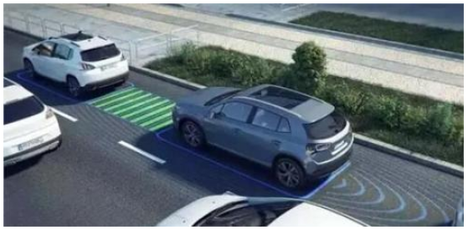
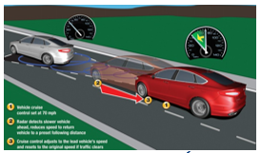
Tech. planning China
L3 Experience
Voice Enhanced Adaptive Cruise Control w/ Stop & Go
Submitted 20CY
New One Pager
Adaptive Cruise Control (ACC) is an increasingly popular safety technology. ACC systems use on-board sensors and software to automatically manage the distance between your vehicle and the vehicle that you’re following. The ACC system maintains a preset following distance by controlling vehicle speed, applying the brakes when necessary.
Through the voice prompt and guidance to reduce the user's uneasiness in the process of override and go & stop. Make users feel more comfortable in temporary take over and ACC.
go
Customers can release their attention and hands as much as possible in the ACC assisted process to avoid the risk of fatigue driving. In this process, the voice prompt can reduce the customer's uneasiness caused by the interaction between acceleration and deceleration and the vehicle in front during the use of ACC, as well as the prompt and guidance of cruise state switching
stop
Help Me Drive
Auto-Commute Experience?
When in the following scenes of Standby, Cruise, Follow, Override, Downshift advise, Brake capacity warning in ACC, add voice reminder and guidance in the function interface in IVI
Compare with ACC, which can follow leading vehicle to stop and automatically accelerate from stop to follow the vehicle within 3 seconds. In the process of Accelerate & Stop operation, add voice reminder about front car behavior to tell customer no worry
ACC G&S with acceleration and deceleration voice reminder of front car
ACC sketch map
Add voice reminder & guidance in ACC G&S which is an enhancement over current solution in both use scenarios and automation levels, based on the same hardware platform. It strengthens Ford vehicles’ automation capability, make them more attractive to the customers.
IVI & Cluster UI , Shortcut key(Steer)
Navigation, EManual book, Settings Info book, Demo Mode
VPA, Voice Reminder , Voice Q&A , Voice command , etc.
Notes:
需要包含：自车主动cut-in/lane change

Slide 4
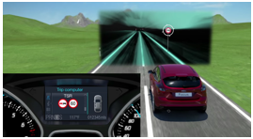
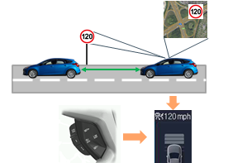
Tech. planning China
L3 Experience
Voice Enhanced Intelligent Adaptive Cruise Control
Submitted 20CY
New One Pager
iACC Sketch Chart
iACC is an enhancement of adaptive cruise control (ACC). It combines ACC with TSR (traffic sign recognition). iACC adjusts the set speed automatically to the current valid speed limit provided by TSR and uses gradual acceleration and deceleration to adjust the vehicle speed accordingly.
Customers can get more traffic information and traffic signs in the process of driving, and adjust the speed limit by voice to drive more safely
When IACC is activated, the camera will recognize the TSR and curve ahead and so on, Cruise speed can be set by voice control. If the cruise speed is greater than the identified speed limit sign, the system will automatically set the cruise speed as the current speed limit
TSR Sketch Chart
Help Me Drive
Auto-Commute Experience?
When automatically update the ACC target speed, add the voice reminder and hint. In the further use the voice command to adjust the speed limit.
When recognize the traffic signal , give customer the voice notifications and the surround vehicle status reminder
Add voice reminder & guidance in iACC which is an enhancement over current solution in both use scenarios and automation levels, based on the same hardware platform. It strengthens Ford vehicles’ automation capability, make them more attractive to the customers.
IVI & Cluster UI , Shortcut key(Steer)
Navigation, EManual book, Settings Info book, Demo Mode
VPA, Voice Reminder , Voice Q&A , Voice command , etc.
Notes:
需要包含：自车主动cut-in/lane change

Slide 5
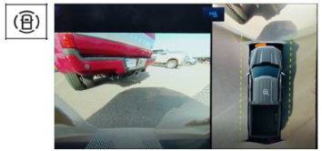
Tech. planning China
L3 Experience
Voice Enhanced Object Detected Camera View(ODCV)
Submitted 20CY
New One Pager
Parking without visibility of what is directly in front of the vehicle can cause stress, due to the possibility of low-speed collisions
Sense obstacles in front of the vehicle and allow the user to visually see their distance from the object, then give customer voice reminder
Users can get voice prompt of distance and object from ODCV to complete parking better and avoid the collision
ODCV will provide additional visual context to the user that front park aid did not previously , allowing the user to see what is in front of the vehicle and judge distance visually in addition to through the use of ultrasonic sensors.
ODCV Sketch Chart
Help Me Drive
Auto-Commute Experience?
ODCV will utilize the front ultrasonic sensors to detect obstacles in front of the vehicle at low speeds(<8 kph). When they do, the center screen will bring up the front 60 image, with park distance indication overlaid on the 360 camera view.
At the same time on the IVI screen will add more helpful function & icons to assist customer complete the parking.
Add voice reminder & distance in ODCV which is an enhancement over current solution in both use scenarios and automation levels, based on the same hardware platform. It strengthens Ford vehicles’ automation capability, make them more attractive to the customers.
IVI & Cluster UI , Shortcut key(Steer)
Navigation, EManual book, Settings Info book, Demo Mode
VPA, Voice Reminder , Voice Q&A , Voice command , etc.
Notes:
需要包含：自车主动cut-in/lane change

Slide 6
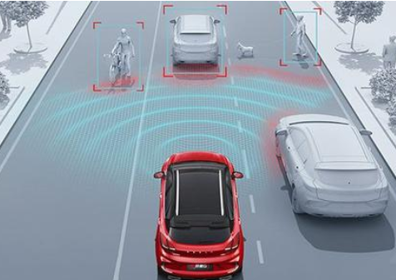
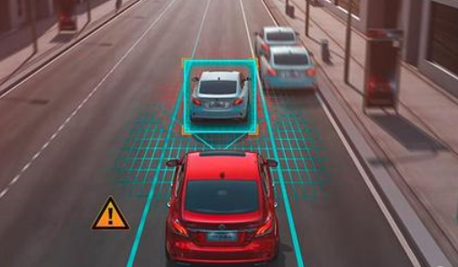
Tech. planning China
L3 Experience
Voice Enhanced Automatic Emergency Braking(AEB)
Submitted 20CY
New One Pager
AEB Sketch Chart
AEB using radar and cameras the system detects an impending forward collision with another vehicle, pedestrian, cyclist and attempts to avoid or mitigate the collision by emitting an audible and visual warning and then aggressively applying the brakes
By turning on the AEB function, customers can avoid all kinds of collisions in traffic accidents, and the early warning before the crisis can reduce the collision risk as much as possible
AEB helps compensate for a driver’s distraction or poor judgement leading up to rear-end collisions. AEB will first give a warning and then, if necessary , apply the brakes. This helps reduce driver anxiety by providing a copilot in certain scenarios.
AEB reminder on IVI Sketch Chart
Help Me Drive
Auto-Commute Experience?
AEB can send out warning by voice and give collision warning prompt on IVI. After braking, AEB can give customers reset function to remind users of the effective range to avoid collision and improve their current restless state
Add voice reminder in AEB which is an enhancement over current solution in both use scenarios and automation levels, based on the same hardware platform. It strengthens Ford vehicles’ automation capability, make them more attractive to the customers.
IVI & Cluster UI , Shortcut key(Steer)
Navigation, EManual book, Settings Info book, Demo Mode
VPA, Voice Reminder , Voice Q&A , Voice command , etc.
Notes:
需要包含：自车主动cut-in/lane change

Slide 7
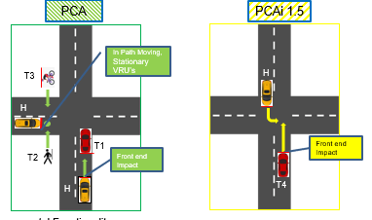
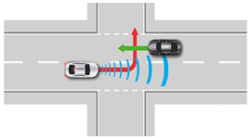
Tech. planning China
L3 Experience
Voice Enhanced Pre-Collision Assist System - Intersection(PCAi)
Submitted 20CY
New One Pager
Driving safety is among the top of drivers priorities. PCAi will sense oncoming traffic when preparing to cross traffic, and apply the brakes if the vehicle is at the risk of being hit while crossing traffic.
Difference between PCA and PCAi Sketch Chart
PCAi will use the front camera and radar to detect oncoming traffic and determine if the driver’s vehicle will collide with oncoming traffic when crossing. If there is the risk of a collision, the vehicle will apply the brakes to mitigate or avoid the collision.
PCAi is an evolution within the PCA feature. PCAi covers predicted trajectory intersecting collisions.
PCAi will add protection and assistance when crossing oncoming traffic, and help ensure that the vehicle passes through traffic safely
PCAi – Intersection Assistant sketch chart
Help Me Drive
Auto-Commute Experience?
PCAi is an extension of PCA which delivers FCW，DBS， AEB.
In the crossroads the PCAi will collect the traffic information then give customer the pre-judgement voice reminder.
In the IVI screen, will show the suitable roadmap and the reminder when go and stop with navigation help.
After braking，PCAi will help customer go on operation for next step journey.
Add voice reminder in PCAi which is an enhancement over current solution in both use scenarios and automation levels, based on the same hardware platform. It strengthens Ford vehicles’ automation capability, make them more attractive to the customers.
IVI & Cluster UI , Shortcut key(Steer)
Navigation, EManual book, Settings Info book, Demo Mode
VPA, Voice Reminder , Voice Q&A , Voice command , etc.
Notes:
需要包含：自车主动cut-in/lane change

